Slide 1
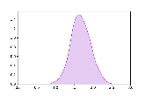
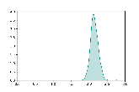
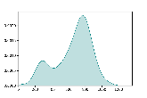
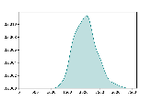
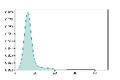
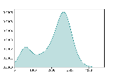
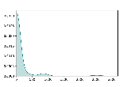
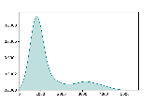
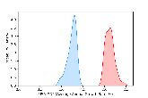
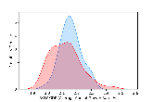
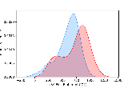
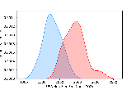
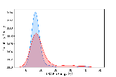
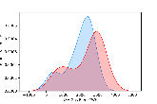
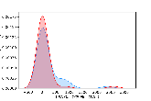
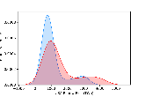
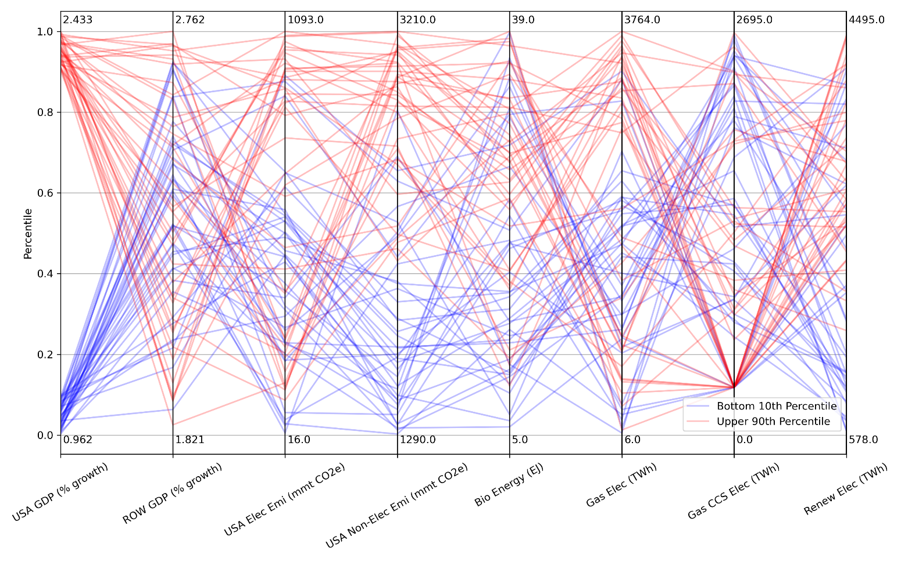
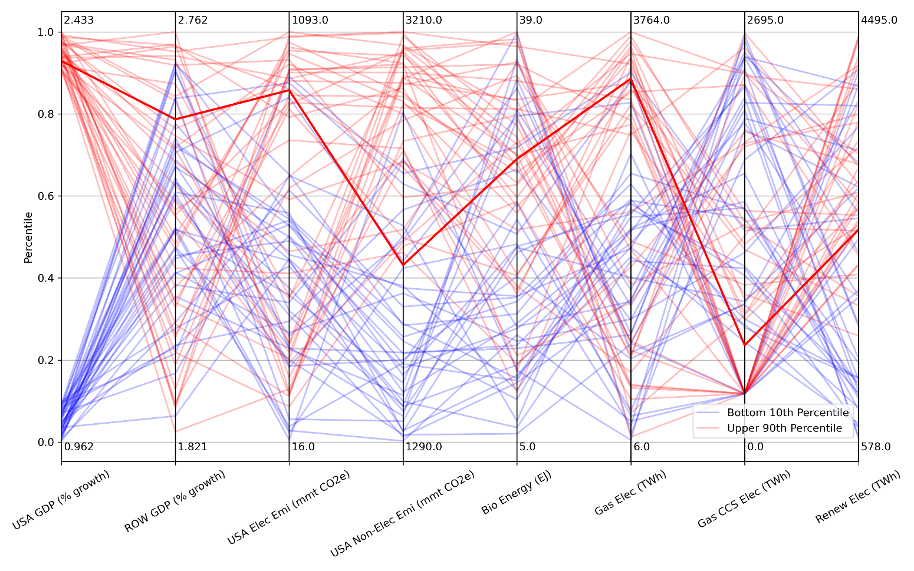
Quantifying Socio-Economic Uncertainty
Objective: Combine traditional uncertainty quantification with scenario discovery techniques to explore the range and likelihoods of socio-economic outcomes, investigate how those outcomes are related, and home in on scenarios of interest.
Probability Distributions for full ensemble
Probability Distributions for high and low sets of outcomes
Max values
Findings: Many patterns of energy and technology development are possible under a given long-term environmental pathway or a given economic outcome.
Impact: Unique approach quantifies multi-sector risks, which can aid decision-making about energy and technology choices and sectoral strategies. It can also identify scenarios of interest and help avoid biases in perceptions of what “needs” to happen to achieve certain outcomes.
Min values
How are different outcomes related?
Which scenarios are most interesting/relevant?
Morris, J.F., J.M. Reilly, S. Paltsev, A. Sokolov and K. Cox, Representing Socio-Economic Uncertainty in Human System Models, Earth’s Future Vol. 10, Issue 4 (April 2022)

