Slide 1
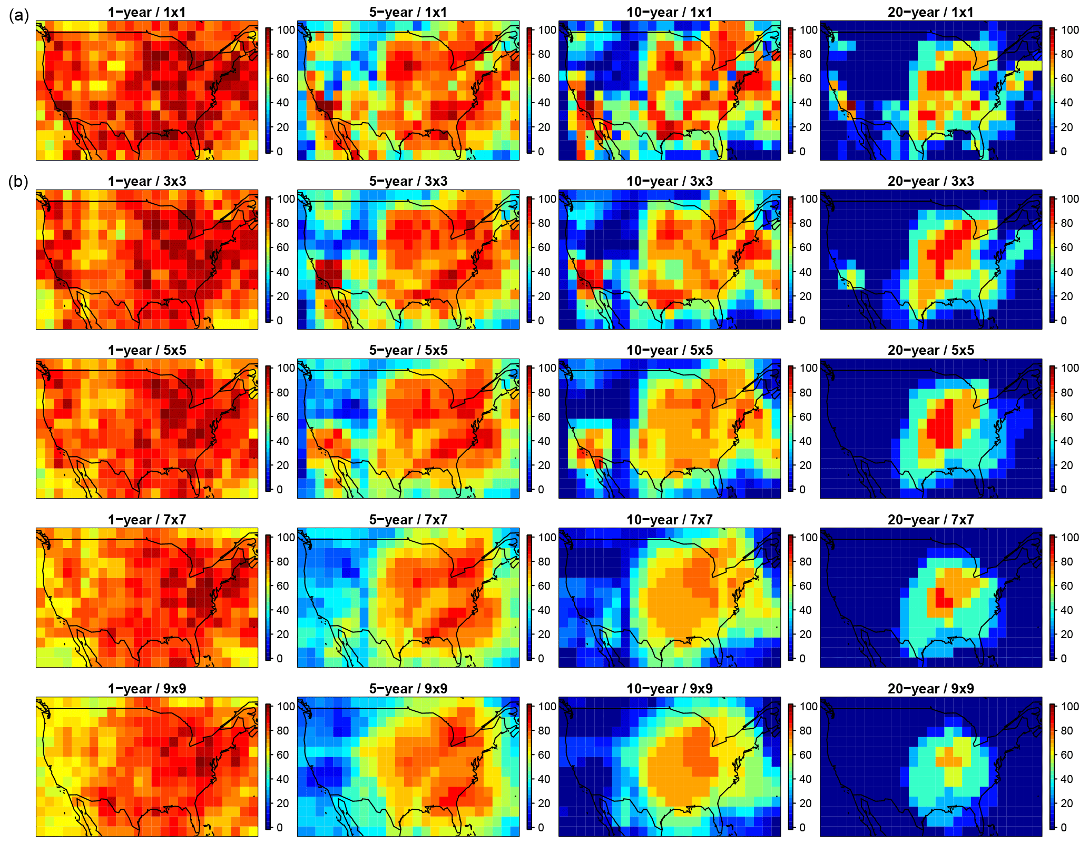
Tracking air quality changes across space and time
Objective: Develop method to detect, within selected regions and timeframes, air quality change signals, whose magnitude can be smaller than that of underlying natural variations in atmospheric conditions.
Findings: MIT researchers developed a way to systematically identify a data set’s “sweet spot”—the number of kilometers and years over which to average the data so as to detect the signal most efficiently.
Impact: This method could improve researchers’ understanding of and ability to track air quality trends, and is applicable not only to surface ozone data but also to a wide range of modeled or observational data.
Combined impact of various temporal averaging windows (columns, 1, 5, 10, and 20 years) and various spatial averaging sizes (rows, ranging from a single grid cell, top row, to an average extending out 4 grid cells in either direction, bottom row) on the percent likelihood that the estimate of surface ozone is greater than 0.5 ppb away from the actual, long-term value.
Brown-Steiner, B., N. E. Selin, R.G. Prinn, E. Monier, S. Tilmes, L. Emmons and F. Garcia-Menendez (2018): Maximizing ozone signals among chemical, meteorological, and climatological variability. Atmospheric Chemistry and Physics, 18: 8373-8388 (doi: 10.5194/acp-18-8373-2018)

