Slide 1
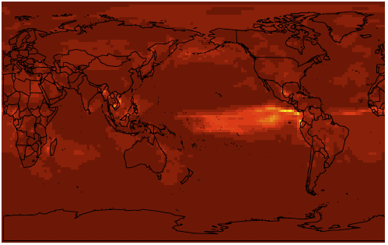

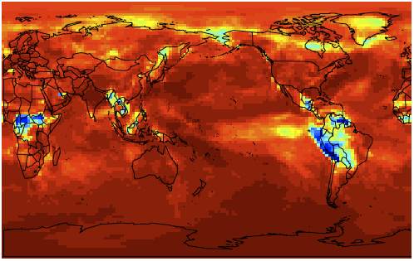
Faster, more efficient simulations of the Earth’s atmosphere
Objective: Devise strategy to incorporate simplified chemical mechanisms in atmospheric simulations that can match results produced by the more complex mechanism for most regions and time periods.
Findings: For most regions and time periods, differences in simulated ozone chemistry between three tested mechanisms is smaller than the model-observation differences.
Impact: If implemented in a 3D Earth-system model, the new MIT modeling strategy could enable scientists to perform low-cost, rapid atmospheric chemistry simulations that cover long time periods under a wide range of scenarios. This strategy could improve understanding of complex multi-sector interactions with the Earth system and provide a powerful risk assessment tool.
Coefficient of Determination (R²) between the most complex mechanism in this study and a middle-complexity mechanism (top) and the simplest mechanism (bottom) for summertime surface ozone. An R² of 1 signifies a 1-1 correspondence in results.
Brown-Steiner, B., N.E. Selin, R. Prinn, S., L. Emmons, J. Lamarque and P. Cameron-Smith
(2018): Evaluating Simplified Chemical Mechanisms within CESM Version 1.2 CAM-chem (CAM4): MOZART-4 vs. Reduced Hydrocarbon vs. Super-Fast Chemistry. Geoscientific Model Development, online first (doi: 10.5194/gmd-2018-16)

