Slide 1
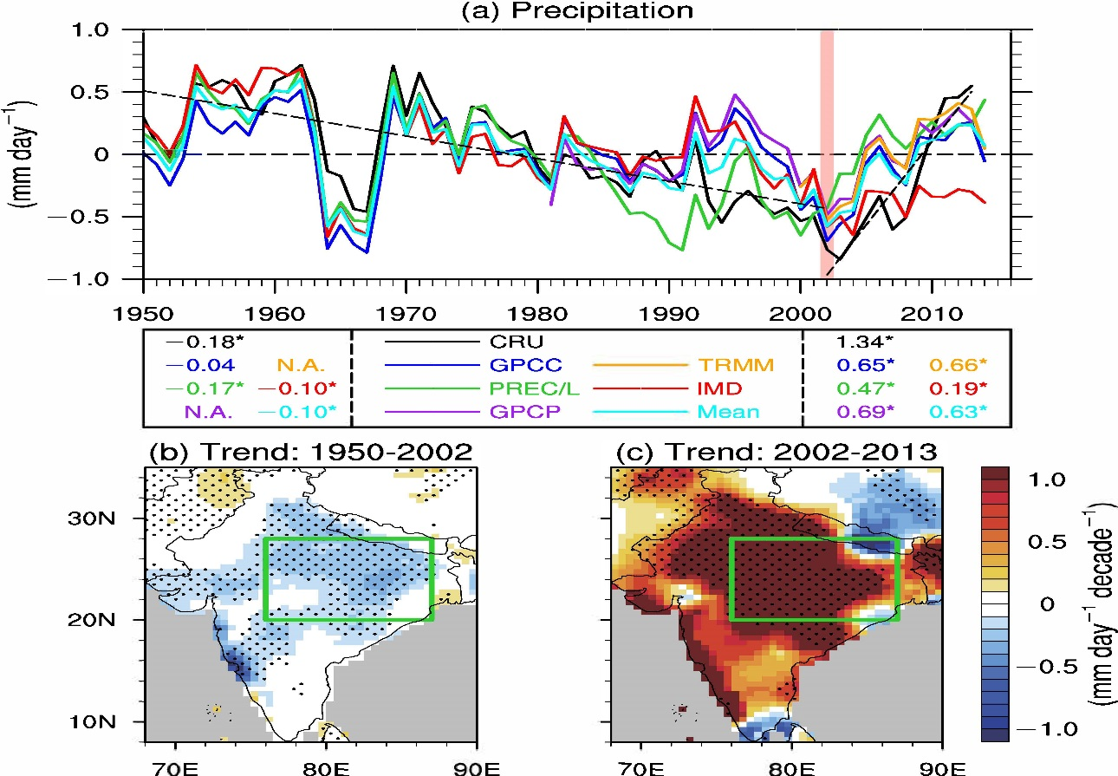
A revival of Indian summer monsoon rainfall since 2002
Objective: Using data obtained from ground-based and satellite observations, measure change in summer monsoon rainfall in North Central India since 2002.
Findings: North Central India summer monsoon rainfall has increased at a rate of 1.34 millimeters per day per decade since 2002.
Impact: Prediction of long-term monsoonal rainfall variations is critical to securing water supplies and planning agricultural and other economic activities in monsoonal regions. Enhanced knowledge about such variations can help scientists to improve Earth-system models to more precisely project future climate change.
Monsoon rains combined with a tropical depression to leave
North Central India experienced a significant drying trend of 0.18 mm/day/decade during 1950–2002 and significant wetting trend of 1.34 mm/day/decade since 2002. Colors in (a) represent various data sets used in the study.
Jin, Q. and C. Wang, 2017: A revival of Indian summer monsoon rainfall since 2002, Nature Climate Change, doi: 10.1038/NCLIMATE3348

