Slide 1
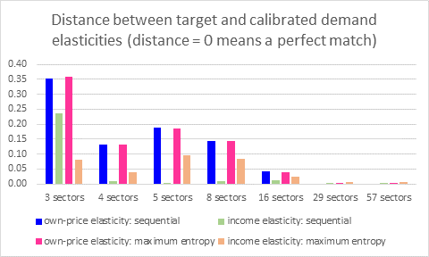
Impact of income growth on patterns of consumption
Objective: Improve projections of energy, water and land use by incorporating a more flexible demand formulation that is better able to represent statistical evidence on the relationship of income growth and demand.
Findings: Under many circumstances, a Constant Difference of Elasticities (CDE) formulation of demand has enough flexibility to be calibrated to target both own-price and income elasticities of demand.
Impact: Accurately capturing the income-elasticity transition as income grows in Integrated Assessment Models (IAMs) is central to understanding projections of future energy-water-land interactions, especially among countries in early- and mid-phases of development.
Based on the study’s Table 3, the figure shows the difference between the targeted elasticity and the calibrated elasticity. With more than eight sectors (typical in more complex applied IAMs such as the MIT IGSM) there is very little error in the calibrated elasticities.
Chen, Y.-H. Henry, 2017: The Calibration and Performance of a Non-homothetic CDE Demand System for CGE Models, Journal of Global Economic Analysis, doi: http://dx.doi.org/10.21642/JGEA.020103AF

